Slide 1

RADIS USER MANUAL

Slide 2
Reading Guide
Please go through the entire manual at least once.
Troubleshoot section contains important steps that you should know before using the system.
It also cover solution for most of the possible bugs.
It is advisable to read the manual and UNDERSTAND the troubleshoot section BEFORE hands on to the system.

Slide 3
In-Car Recording Software (Laptop + Smartphone)

Slide 4
Make sure all the hardware is connected as designed.
Cam #1
Cam #2
Cam #3
PoE switch
(LED blinking)
Power supply
Laptop

Slide 5
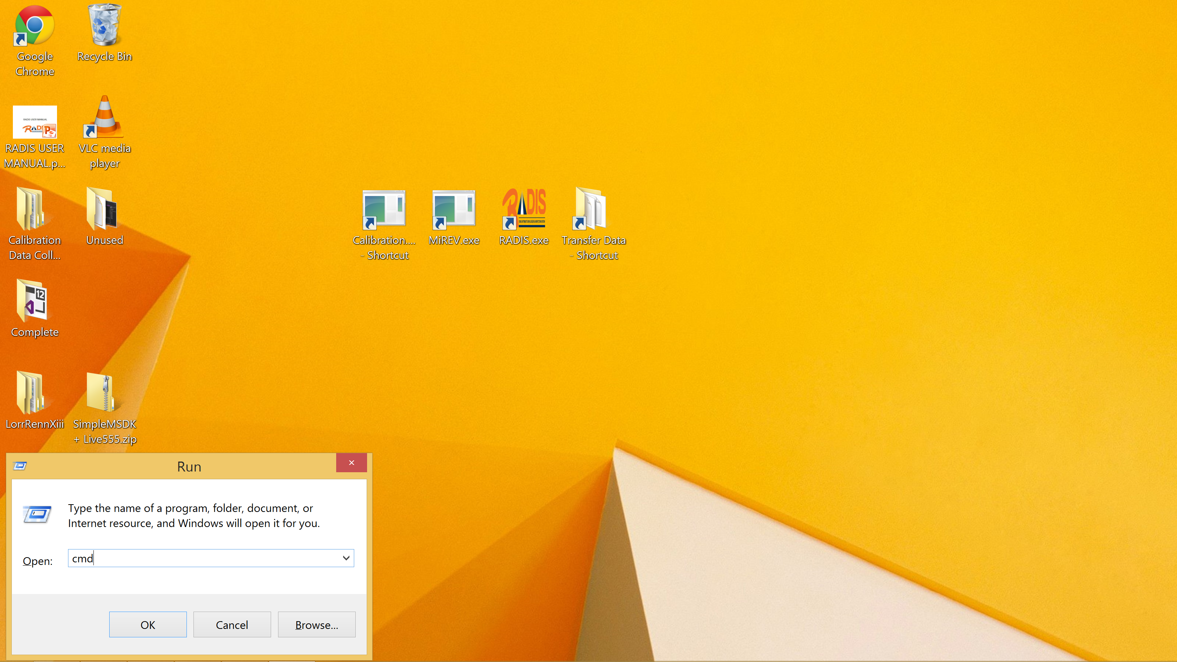
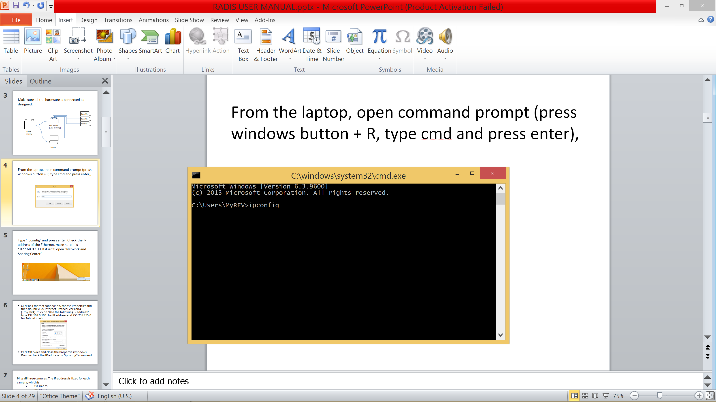
From the laptop, open command prompt (press windows button + R, type cmd and press enter),

Slide 6
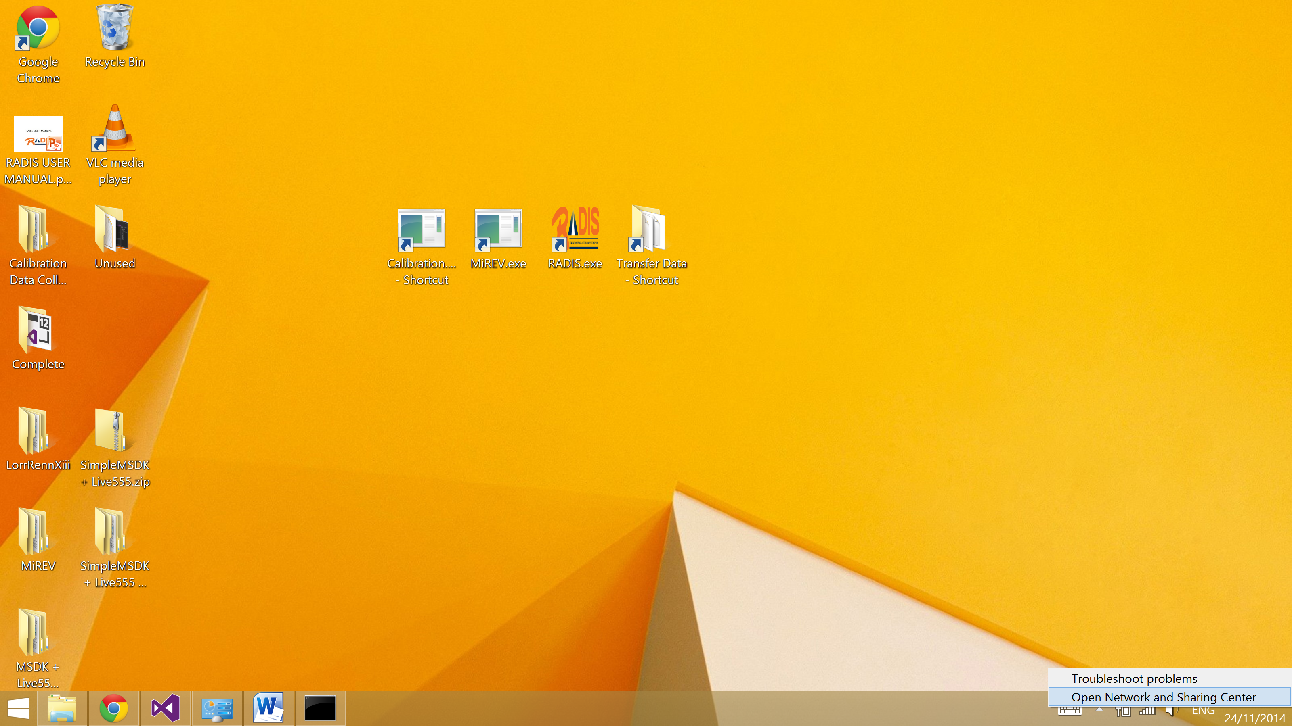
Type "ipconfig" and press enter. Check the IP address of the Ethernet, make sure it is 192.168.0.100. If it isn't, open “Network and Sharing Center”

Slide 7
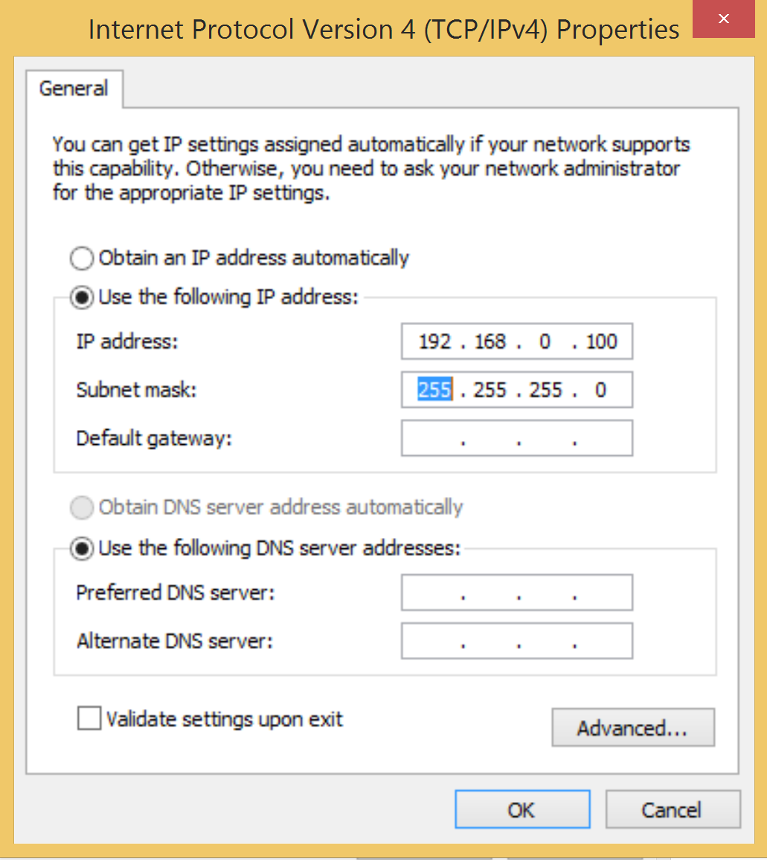
Click on Ethernet connection, choose Properties and then double click Internet Protocol Version 4 (TCP/IPv4). Click on “Use the following IP address”, type 192.168.0.100 for IP address and 255.255.255.0 for Subnet mask.
Click OK twice and close the Properties windows. Double check the IP address by “ipconfig” command

Slide 8
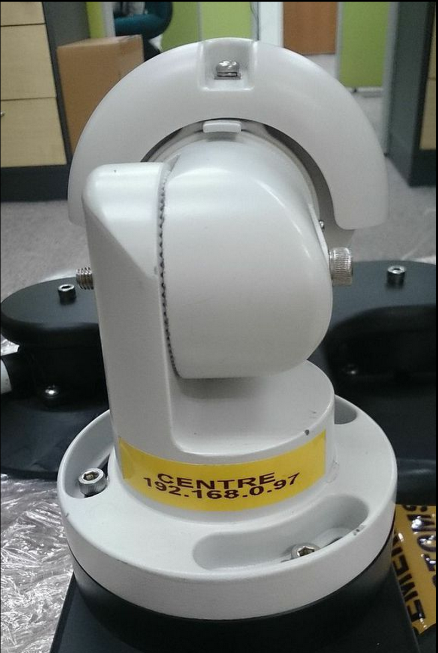
Ping all three cameras. The IP address is fixed for each camera, which is
192.168.0.95
192.168.0.96
192.168.0.97
respectively. The camera IP is tagged on the camera itself.

Slide 9
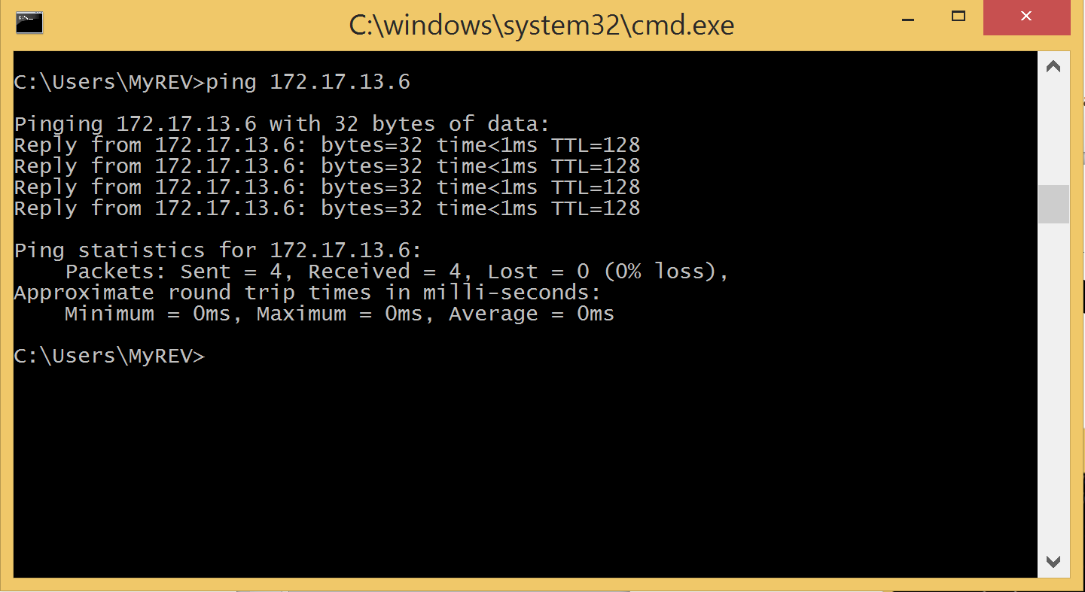
Type "ping 192.168.0.95" in command prompt and press enter, if the connection of camera is secure, the ping result should be positive reply.

Slide 10
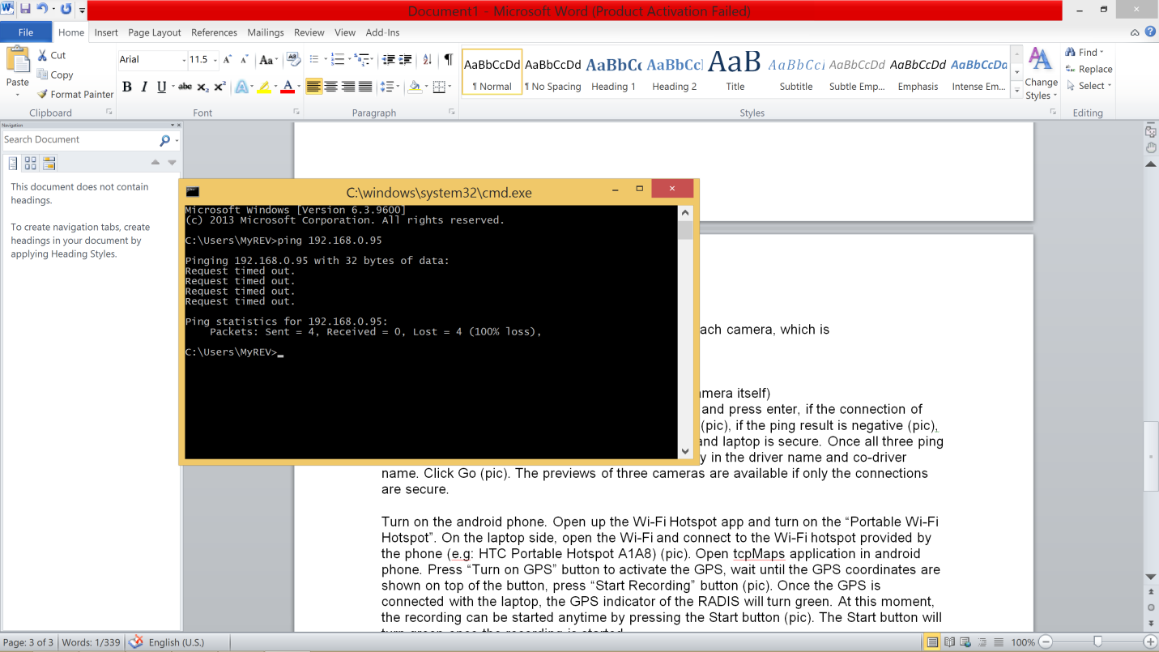
If the ping result is negative such as “Result timed out” or “Destination host unreachable”,
please make sure the connection between cameras and laptop is secure.

Slide 11
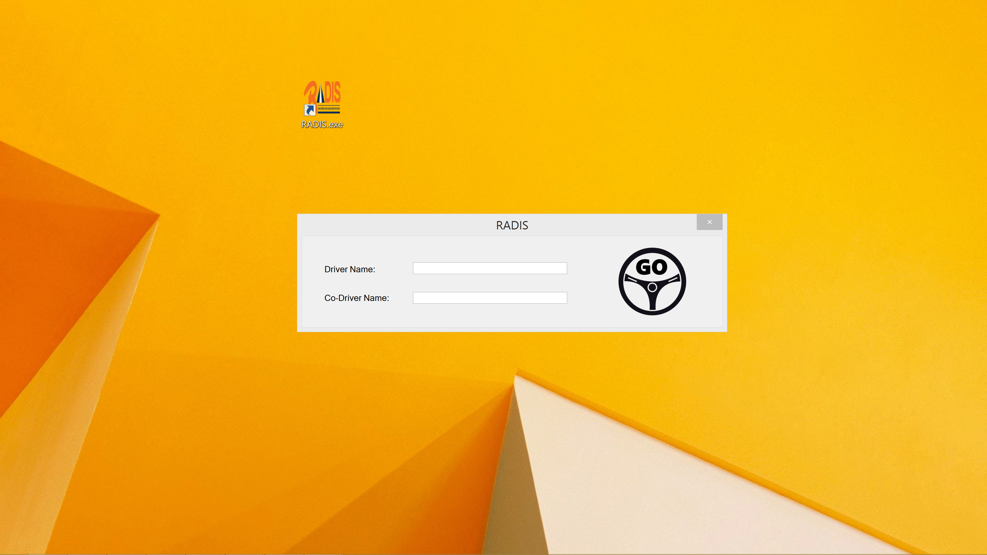
Once all three ping results return positive, open RADIS.exe

Slide 12
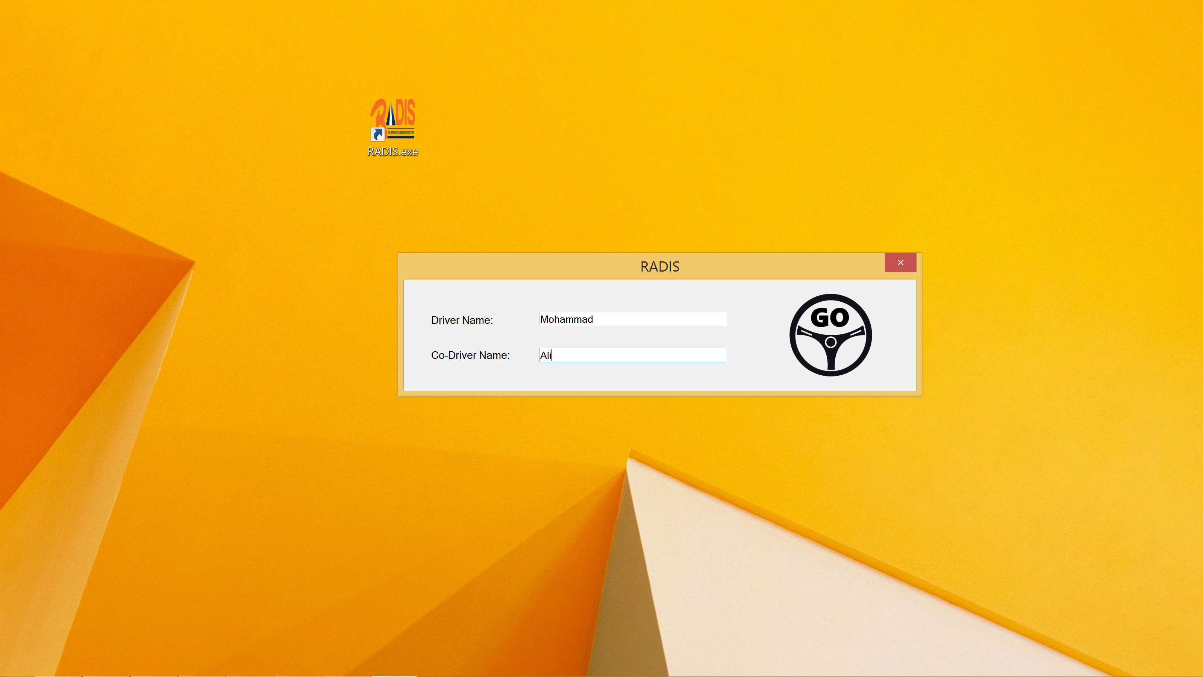
Enter driver and co-driver name then click GO button

Slide 13
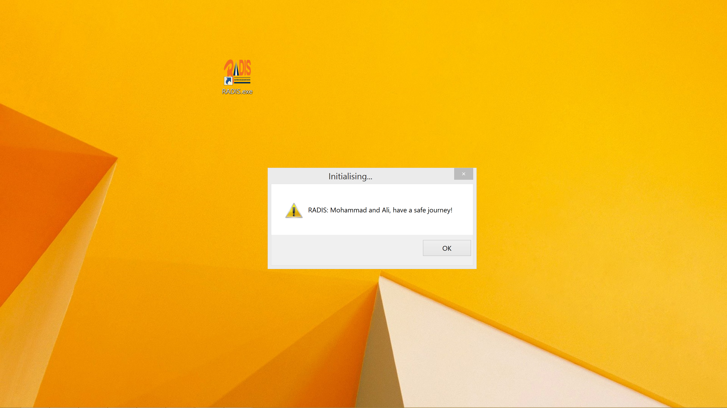
Click OK

Slide 14
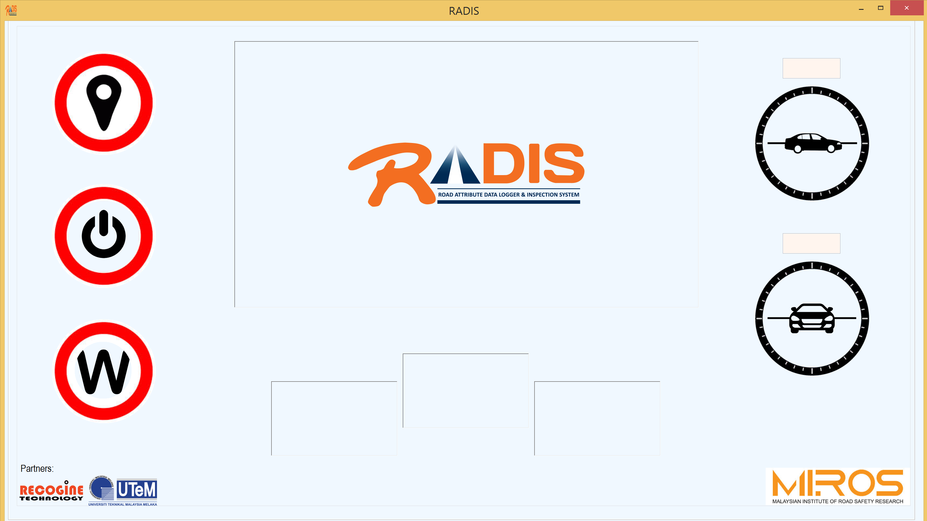
The live previews of three cameras are only available if the connections are secure.
PREVIEW 1
PREVIEW 2
PREVIEW 3

Slide 15
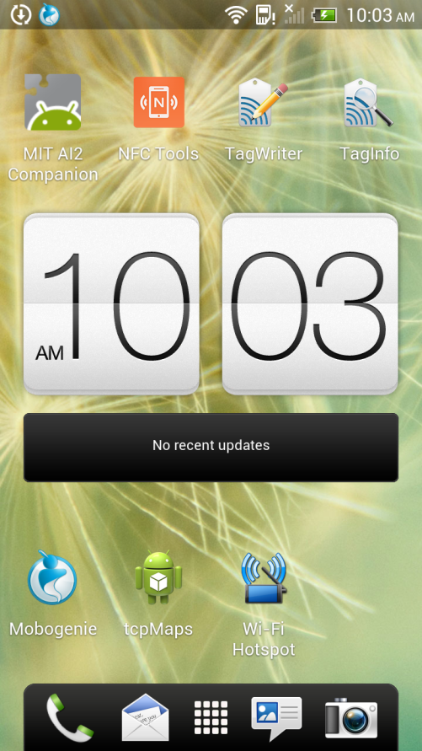
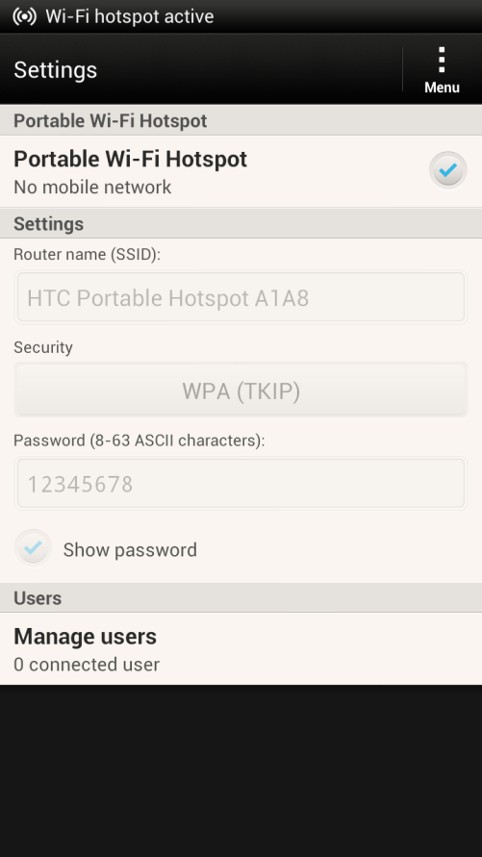
Turn on the android phone. Open up the Wi-Fi Hotspot app and turn on the “Portable Wi-Fi Hotspot”.

Slide 16
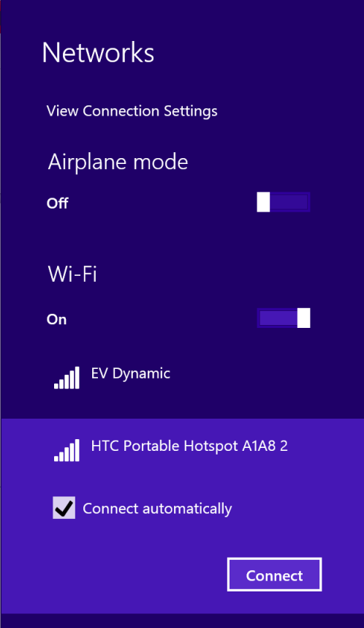
On the laptop side, open the Wi-Fi and connect to the Wi-Fi hotspot provided by the phone (e.g: HTC Portable Hotspot A1A8 2)

Slide 17

Open tcpMaps application in android phone.

Slide 18
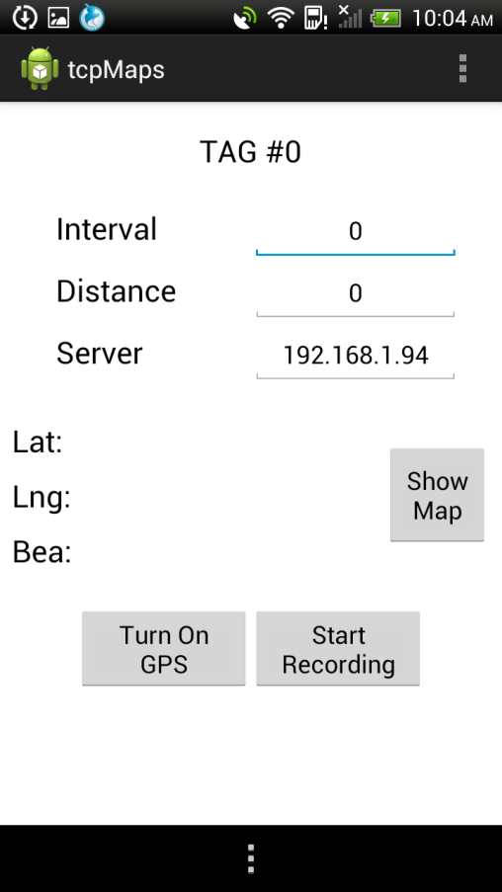
Press “Turn On GPS” button to activate the GPS, wait until the GPS coordinates are shown then press “Start Recording” button.
2.977364
101.797492
0.0

Slide 19
Once the GPS is connected with the laptop, the GPS indicator of the RADIS will turn green.

Slide 20
Note: The IP address of the laptop’s Wi-Fi adapter is pre-configured at 192.168.1.94.
If the recording is started but the GPS indicator over the laptop is not green, there is probably the server IP is changed unexpectedly. Kindly refer to the slide #5 to troubleshoot it. Open the Wi-Fi properties and change the IPv4 address and subnet mask into 192.168.1.94 and into 255.255.255.0 respectively.

Slide 21
Once the GPS is connected with the laptop, the GPS indicator of the RADIS will turn green. At this moment, the recording can be started anytime by pressing the Start button.
Note: The laptop is server while the smartphone is client. Never start the client before starting the server.

Slide 22
Road Coding Software

Slide 23
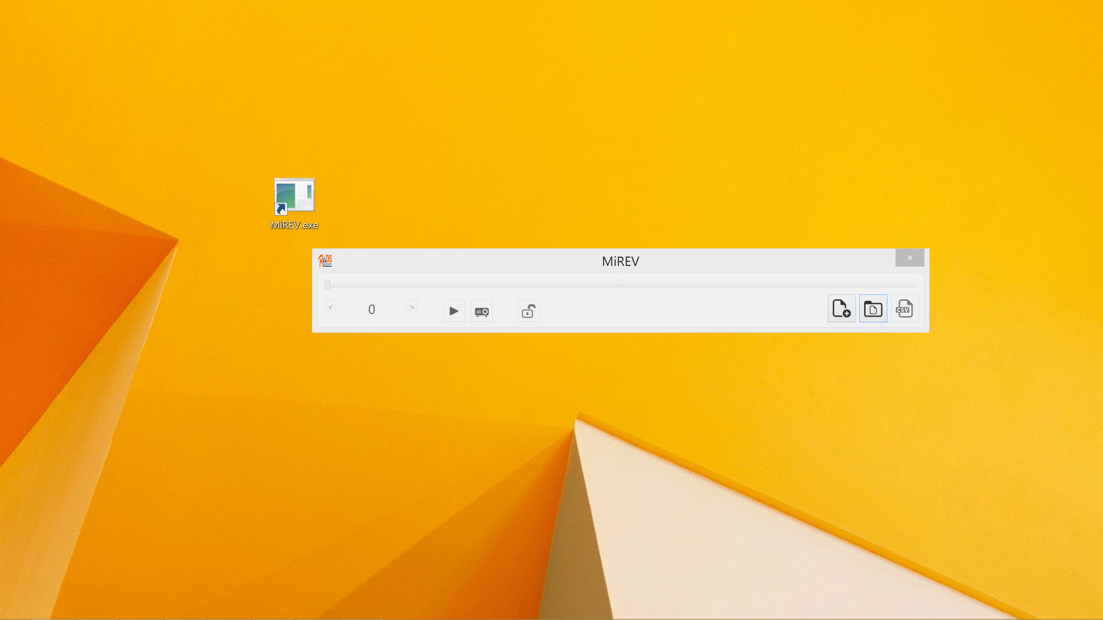
Open MiREV.exe

Slide 24
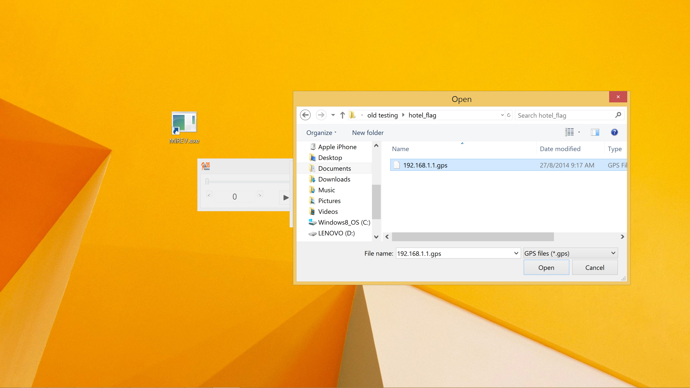
For a new road survey, press the “New Project” button. A Project Import window will prompt out. Enter the coder name and click on “Browse” to search for the file directory that contains the new road survey recording file (.gps).

Slide 25
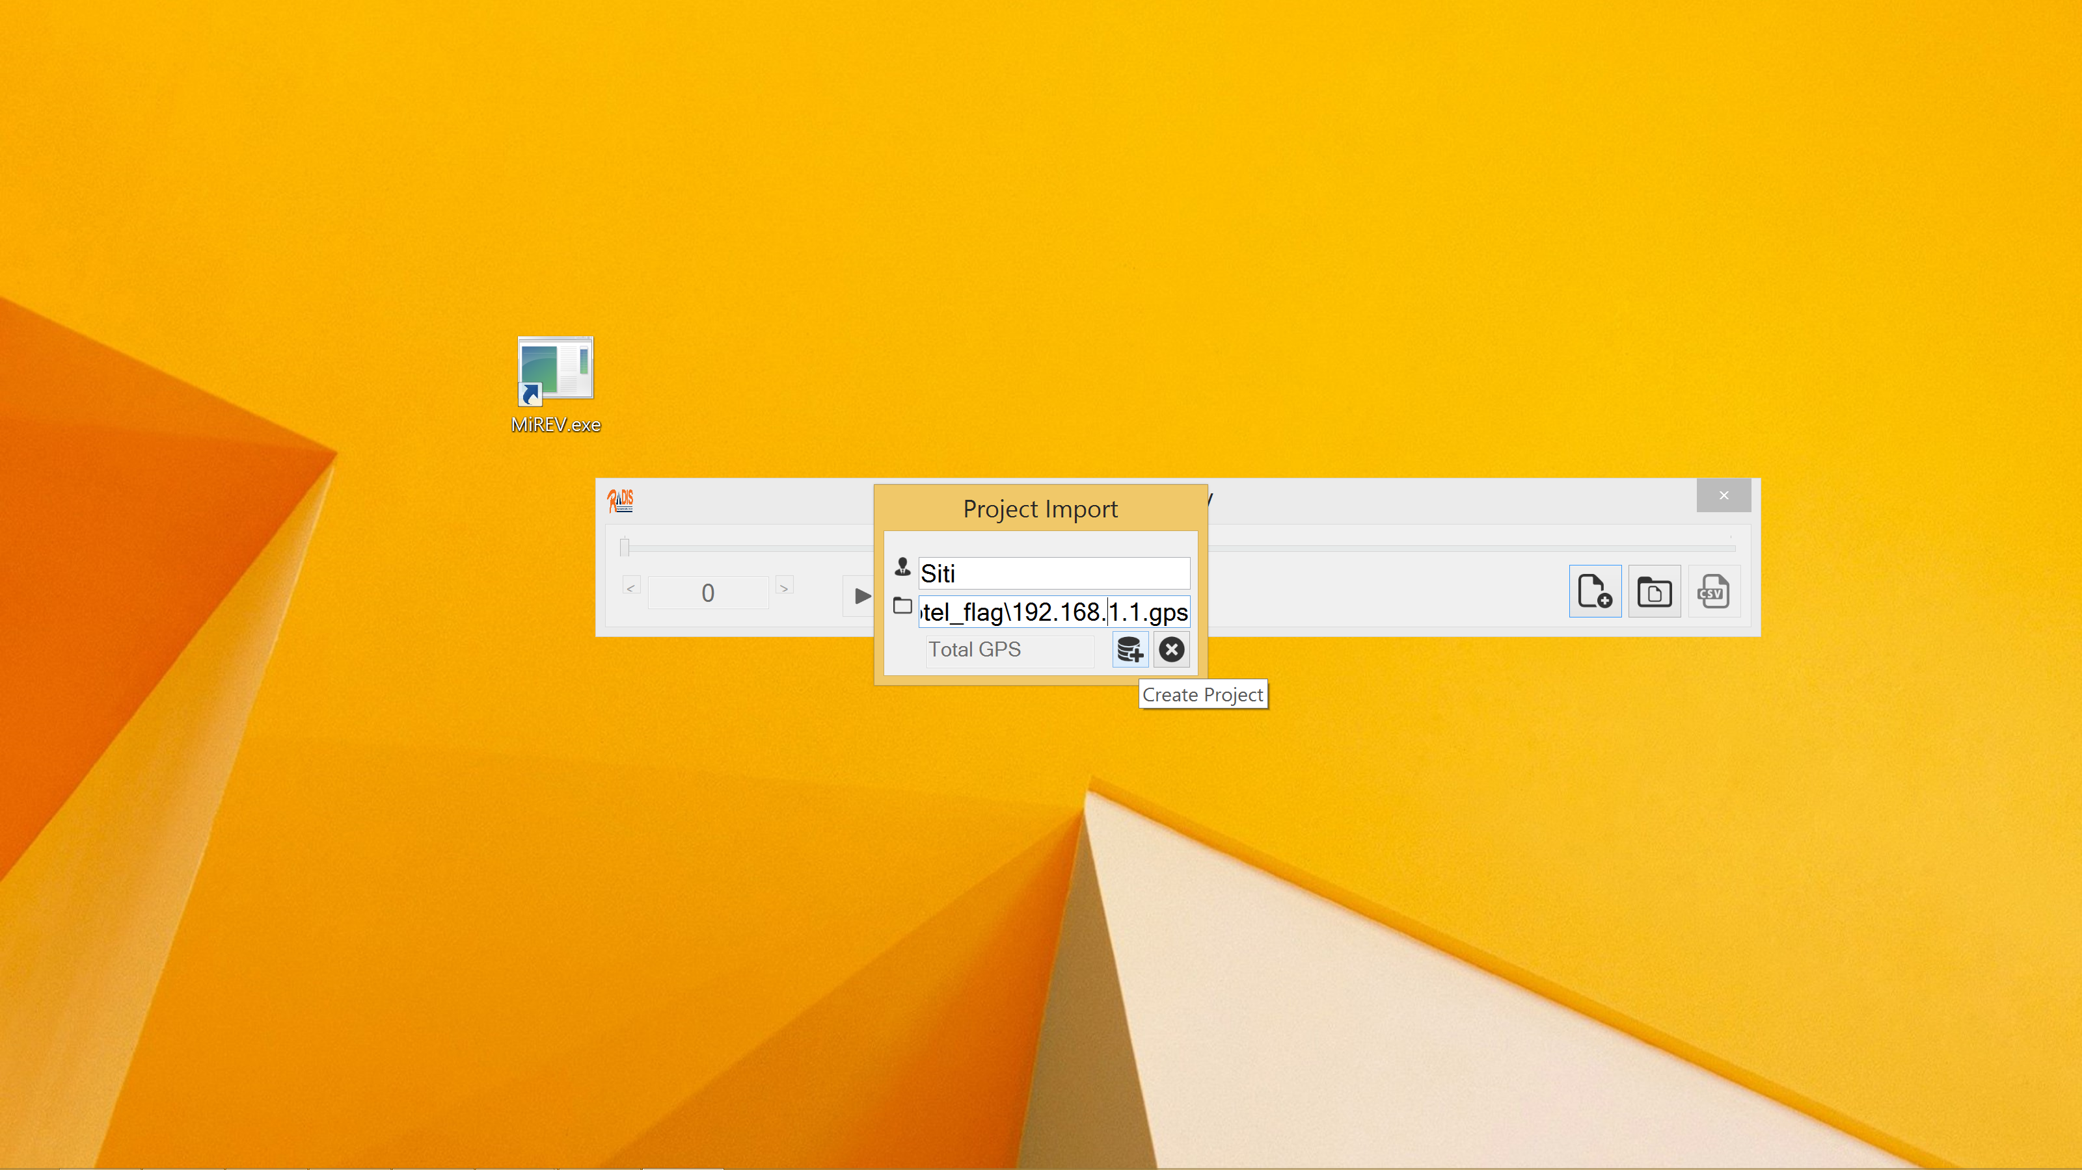
Select a GPS file and open. Click the “Create Project” button in Project Import window

Slide 26
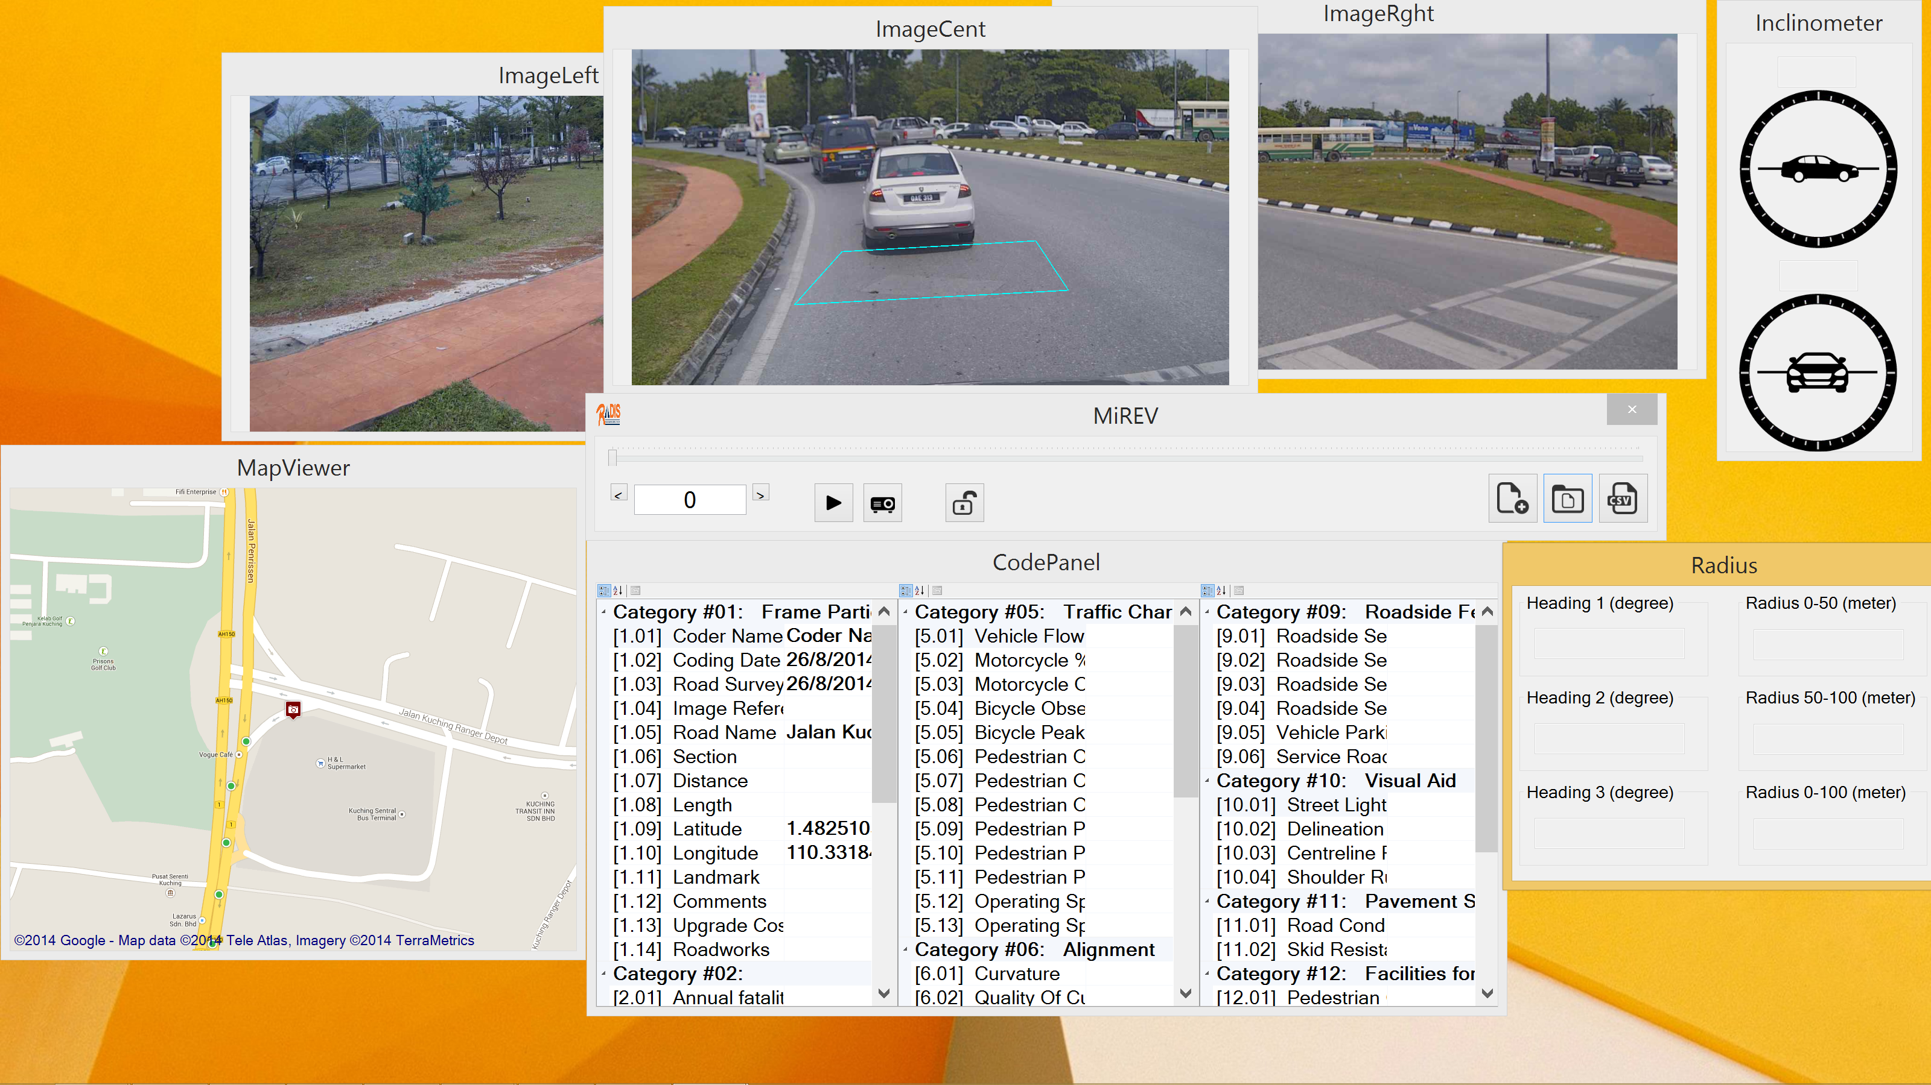
Wait for several minutes until all the relevant files are extracted. After done, multiple windows will prompt out.

Slide 27
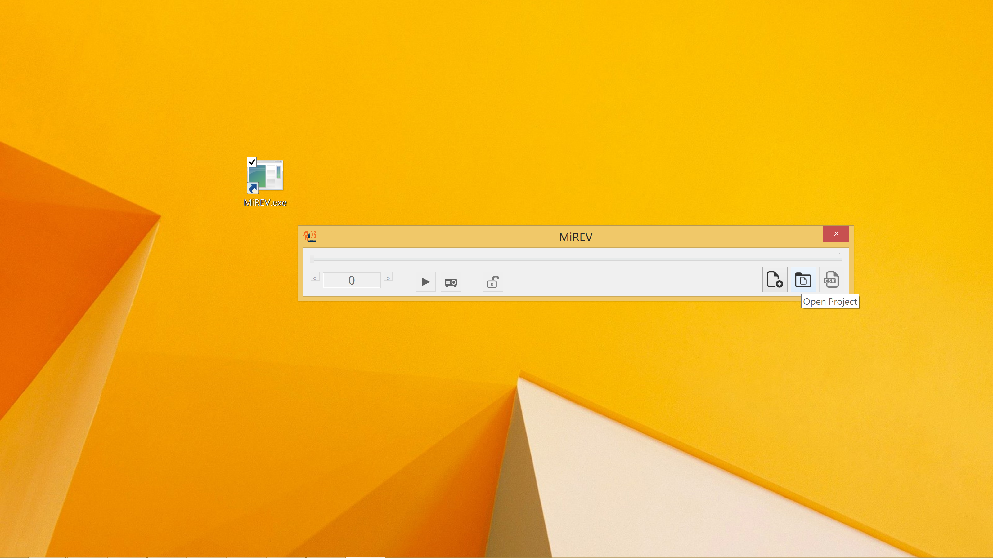
If the project is already created, click “Open Project” button to load the project file. Browse to the desired project directory and open the Project File (.mdf).

Slide 28
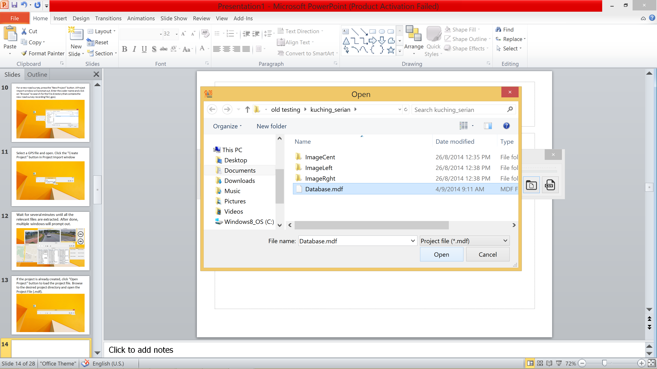

Slide 29
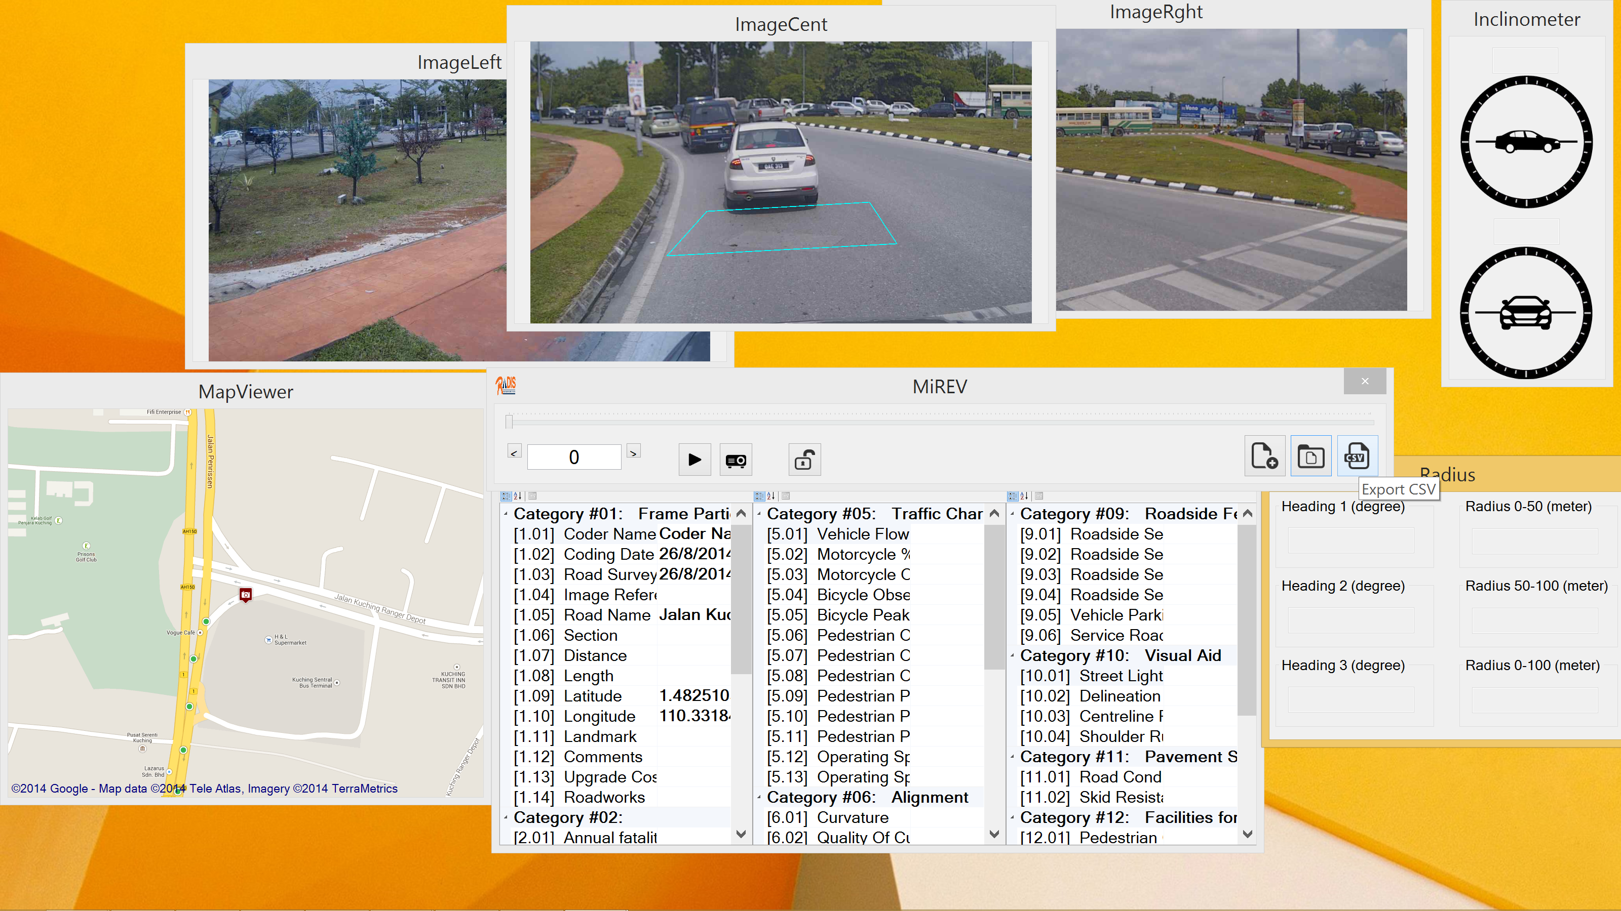
When the coding is done, click “Export CSV” button to convert all the data into CSV file format.

Slide 30
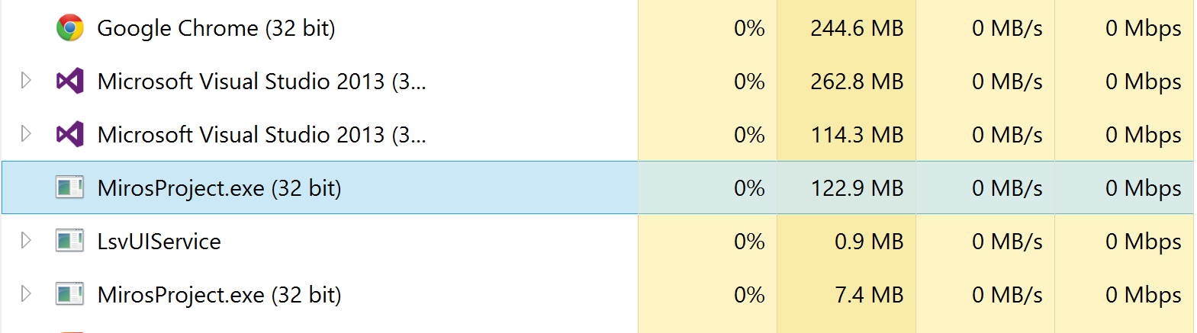
Troubleshoot
If the RADIS software cannot be opened, try kill the existed task in Task Manager.
Right click MirosProject.exe and choose “End task”. Try open RADIS again.

Slide 31
Troubleshoot
DO NOT open the calibration software before connecting all the three cameras. This will cause the calibration software to take forever to open.
Always ensure the laptop is able to ping all three cameras before proceed to calibration or recording.

Slide 32
Important Steps
This is the steps after each recording is complete:
Search for the corresponding folder that contain the latest recording files (usually having the latest time at the filename).
Change the filename of 192.168.0.95.video to 192.168.0.95.mjpeg, same for the other two.
Change the filename of 192.168.0.95_ts.txt to 192.168.0.95.time, same for the other two.
Copy the three files (height.calib, homography.calib, homography.box) into each folder that contain the six files of 192.168.0.9X which you are going to extract using the coding software. Beware that there are not just total six files inside the folder, there is .gps file as well.

Slide 33
Important Steps
Copy the folder to the desktop, and run the coding software. Create new project and select the .gps file.
Make sure the .calib files are inside.
Wait for the software to extract for the first time, and it takes some time.

